Slide 1

Hack Utsav 2.0
Hack Elites
TEAM NAME -
JURY PRESENTATION TEMPLATE

Slide 2
Description of Problem Statement
Title of the Problem Statement: An innovative tool that automatically generates comprehensive project documentation by analyzing the code from a given Git repository.
Detailed Description of the Problem Statement: The tool being capable of fetching the codebase, understanding its structure, and extracting essential details like class structures, functions, and APIs. This tool aims to bridge the gap between code and documentation, saving time.
Name SPOC: Abhinav Saxena
Name of Team Members:
Rifah A Khan
Chinmayee N Swamy
Department: ITH/TC
Customer Experience
Non-customer experience
Project Goal:
Codebase Analysis
Documentation Generation
Customization
Multi-format output
Download Option
Which GenAI tool/technique used to solve the problem?
Integrating OpenAI’s GPT-4.o mini model and formulating a structured prompt, the script automates the process of generating documentation for various file types in a codebase.
Customer Benefit:
Time saving
Improved Accuracy
Consistency
Enhanced Collaboration
5. Better code maintenance
Stage:
Ideation
POC
MVP
Pre-Production
Production

Slide 3
Business Value:
1. Reduced time and effort on manual documentation
2. Enhanced code understanding and maintenance
3. Improved Collaboration
4. Customizable documentation for different stake holders
5. Increased code quality and consistency
6. Enhanced knowledge sharing

Slide 4
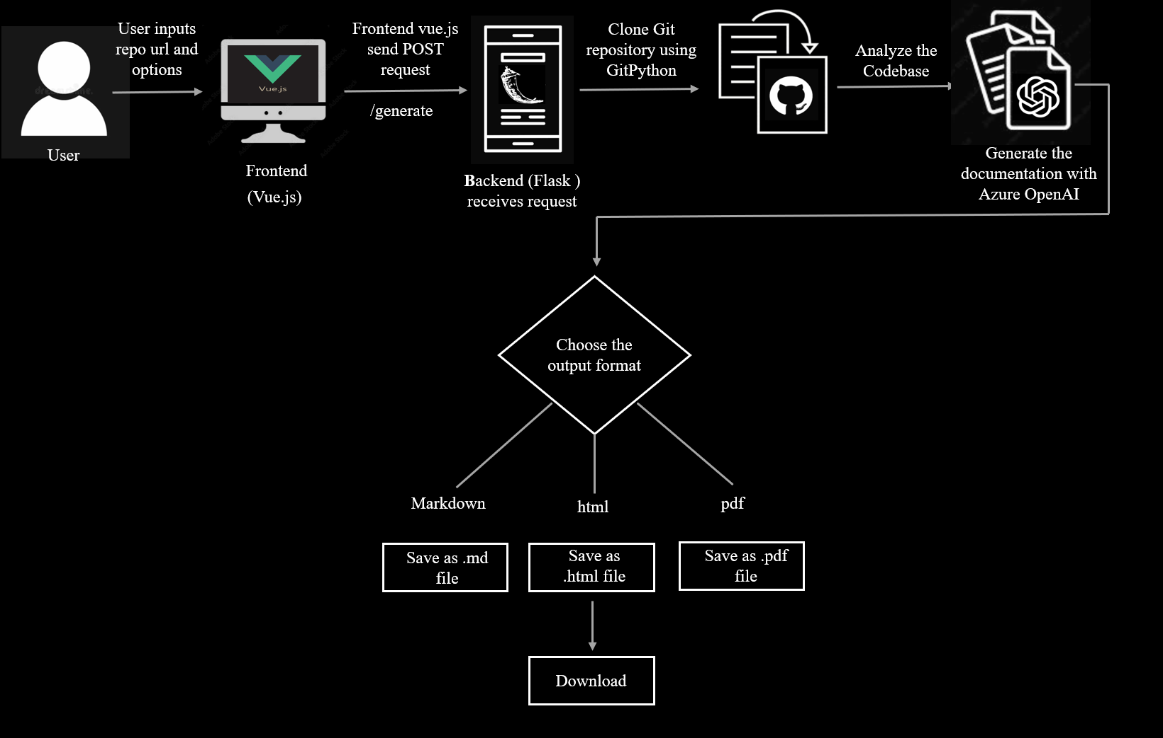
Flow Diagram:

Slide 5
Demo:

Slide 6
Question and Answers

Slide 7
Thank You

